Slide 1
Lab Distributed Systems
Team 404
Bilal Moussa Fares
Mathijs Daemen
Jorre De Backer
Liam Hertoghs
Thomas Verschoor

Slide 2
Goal of the project
Creating a distributed application that uses our own middleware
Various components should have been implemented
Raspberry Pi’s

Slide 3
Team objects
Who? | Implementations
Bilal | Communications, REST, Naming, Replication & Agents
Jorre | Replication, UDP, Agents
Thomas | Communications, XML , REST, Naming, Replication and GUI
Mathijs | TCP, Hashing, Naming, Discovery, Replication, Agents, Cleaning up the code
Liam | Multithreading, communications, REST, Naming, Discovery, Replication, Cleaning up the code, make everything works fine
Everyone: helping testing and debugging + working out the project

Slide 4
Naming server
Hash function: name of node ==> integer value +ip
Now server allows client: listHashmap, addFile, getting
data consistency = semaphores addUser,addFile,exit
Java spring boot
Xml file

Slide 5
discovery
UDP Multicast “Start”
UDP Unicast “Exit”
Server UDP Unicast responses to change previous - and next node on client exit

Slide 6
replication
Start
Update
Shutdown → Use of REST to retrieve IP and previous node from server

Slide 7
agents
Premain
AgentMain
Startup through command line/from inside the code
Multiple libraries with different ways to setup
Jade/instrumentation/…

Slide 8
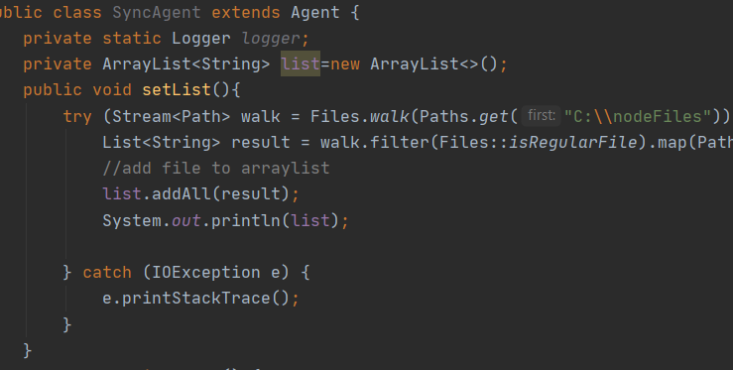
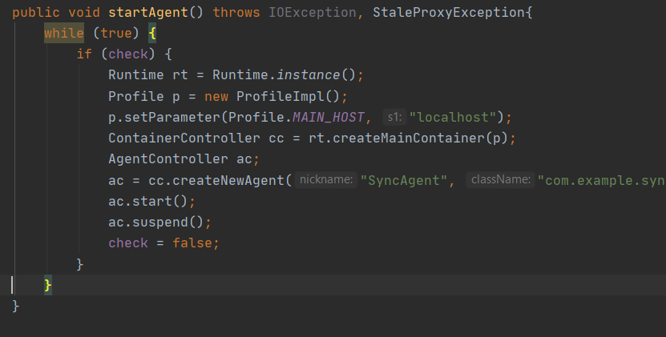
agent
List with all files in a folder
In rest a while loop that checks only when check is set to true (by another node agent)

Slide 9
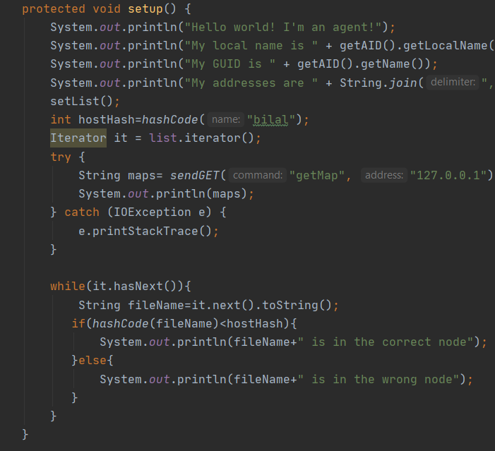
agents
Calculate the hash of the files in the list
Ask server if the file is in the correct node, server would send an IP address back
If the IP address is the same, then it’s in the correct node, else send to the right node

Slide 10
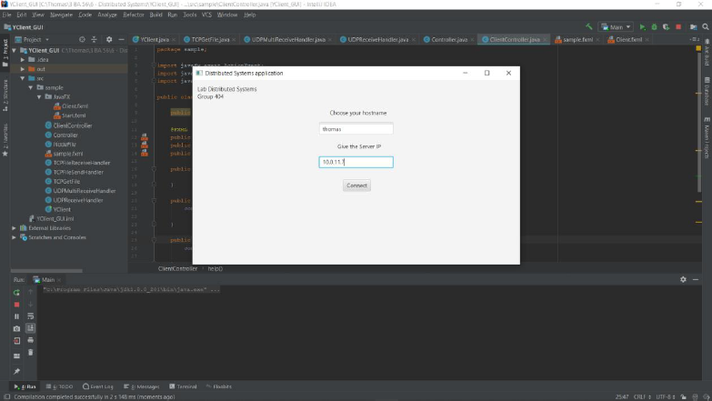
GUI
X11
Swing
JavaFX

Slide 11
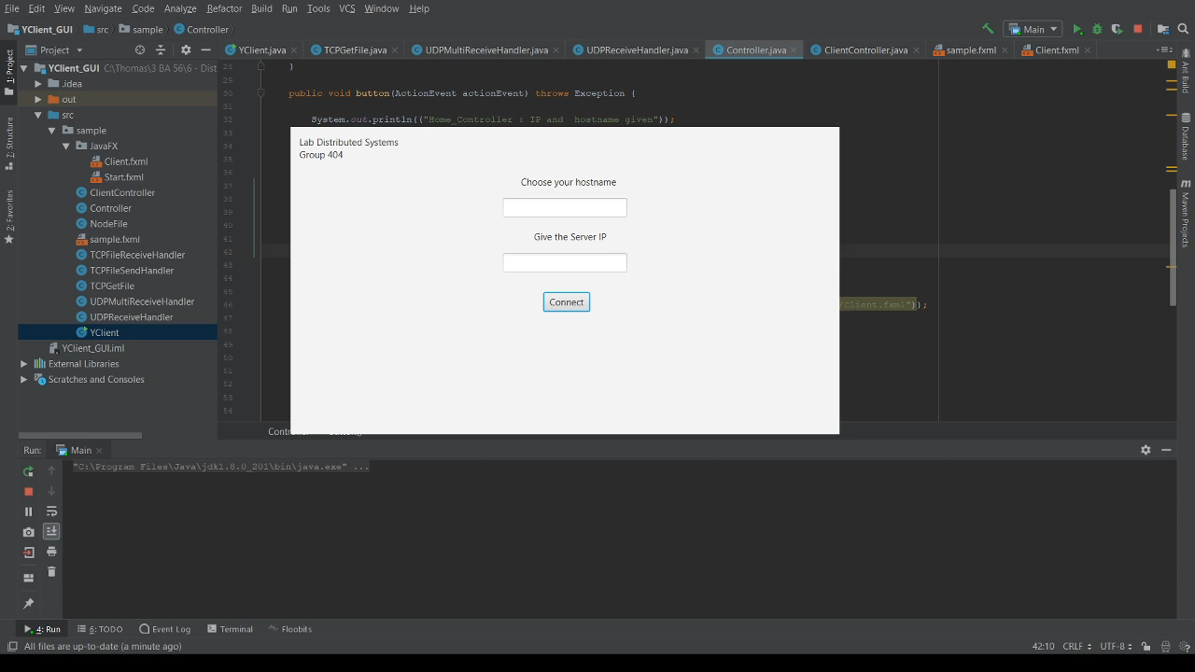
GUI

Slide 12
remarks
Sometimes we still get some exotic errors
Better writing of the code -> we got better view on whole project
Maybe improvement for next years?
Work more efficient: fool proofing > expanding
Wasted a lot of time on sub-projects

Slide 13
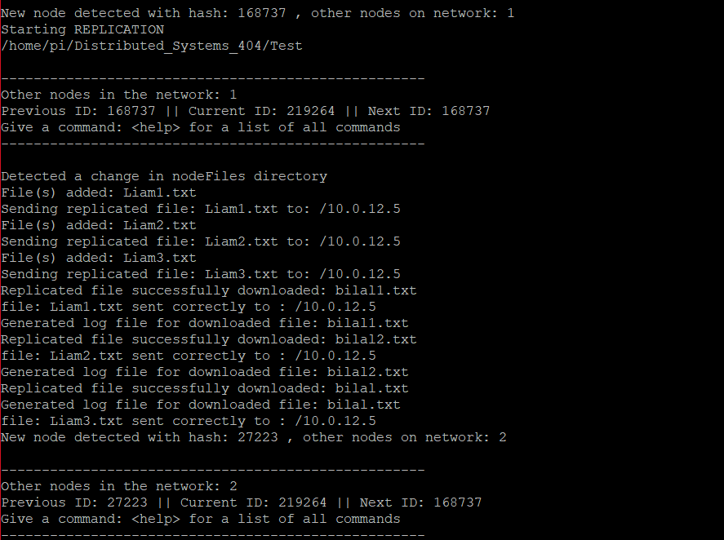
Final result
Live Demo

Slide 14
questions

